Slide 1
4CM525 Functional Programming
Prof Stephan Reiff-Marganiec University of Derby
2024-2025

Slide 2
4CM525 Functional Programming Lecture 8 AVL Trees, Grammar for Maths expressions & Maybe
Prof Stephan Reiff-Marganiec University of Derby
2024-2025

Slide 3
Today
A bit more work with trees: AVL trees
The Maybe type: writing functions that can catch/ manage errors
A brief excursion to the coursework: Grammar for Maths expressions

Slide 4
AVL trees
A self-balancing binary search tree
The depth is always optimal (never more than 1 level apart)
Search, insert and delete are all O(log n) in worst and average case
Compare: binary search tree as worst case complexity of O(n)
Best case could be O(1) … i.e. you need the root element
Named after inventors Adelson and Velsky
There are other balanced trees, e.g. red black trees

Slide 5
The basic data type
Idea: it’s a binary search tree, so we could have an empty tree or one with a left and right branch.
The extra thing we need to track is the height!
data AVLTree a = Empty
| Node a (AVLTree a) (AVLTree a) Int
deriving (Show, Eq)

Slide 6
Concepts of height and balance factor
Height is stored for each node, so we just need to extract!
height :: AVLTree a -> Int
height Empty = 0
height (Node _ _ _ h) = h
Balance factor was defined as:
bf(x) = height(rightSubTree(x)) – height(leftSubTree(x))
balanceFactor :: AVLTree a -> Int
balanceFactor Empty = 0
balanceFactor (Node _ left right _) = height left - height right

Slide 7
Search is easy …
Searching is just like searching any binary search tree, with the tiny difference that the datatype has h which needs to be dragged around as value in definition
search :: Ord a => a -> AVLTree a -> Bool
search _ Empty = False
search x (Node value left right h) | x == value = True
| x < value = search x left
| x > value = search x right

Slide 8
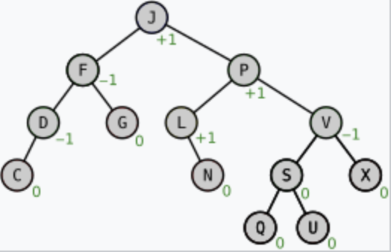

Insert can cause trouble: Getting out of balance
On to the difficult bits!
Let’s look at some examples of the slides where we insert values into an existing tree
As we can see inserting can damage the balance!
This violates the idea of the tree, but crucially has
an impact on the search performance
This Photo by Unknown Author is licensed under CC BY-NC-ND

Slide 9
And fixing things … rotations
If a node ends up with +2 or -2 as balance factor then we need to rebalance
There are 4 cases:
Right Right: Z is a right child of X and bf(Z) >=0 rotateLeft
Left Left: Z is the left child of X and bf(Z) >= 0 rotateRight
Right Left: Z is a right child of X and bf(Z) < 0 rotateRightLeft
Left Right: Z is a left child of X and bf(Z) < 0 rotateLeftRight

Slide 10
Single Rotation: Left Rotation
Right Right: Z is a right child of X and bf(Z) >=0
X is the node with bf +2 (the right subtree is higher by 2 than the left),
Z is it’s right child
2
2
A
A
1
1
0
B
B
B
0
0
0
0
C
C
A
C
New node

Slide 11
Double Rotation: Left Right Rotation
Left Right: Z is a left child of X and bf(Z) < 0
X is the node with bf -2 (the right subtree is higher by 2 than the left),
Z is it’s left child
C
-2
C
-2
C
2
C
2
A
1
1
1
0
A
B
B
1
B
0
0
0
0
0
B
B
A
0
A
C
A
New node

Slide 12
Left Rotation in Code
rotateLeft :: AVLTree a -> AVLTree a
rotateLeft (Node x leftX (Node y leftY rightY _) _) =
let hLeftX = height leftX
hLeftY = height leftY
hRightY = height rightY
in Node y (Node x leftX leftY (1 + max hLeftX hLeftY)) rightY (1 + max (1 +
max hLeftX hLeftY) hRightY)
rotateLeft t = t

Slide 13
Right Rotation in Code (just for completeness)
rotateRight :: AVLTree a -> AVLTree a
rotateRight (Node x (Node y leftY rightY _) rightX _) =
let hLeftY = height leftY
hRightY = height rightY
hRightX = height rightX
in Node y leftY (Node x rightY rightX (1 + max hRightY hRightX)) (1 + max
hLeftY (1 + max hRightY hRightX))
rotateRight t = t

Slide 14
Let’s look at insert then! Slide 1 of 3
We know we’ll need to adjust the node height
updateHeight :: AVLTree a -> AVLTree a
updateHeight Empty = Empty
updateHeight (Node value left right _) = Node value left right (1 + max
(height left) (height right))
Notes:
Look back at where the <, > etc was used …

Slide 15
Let’s look at insert then! Slide 2 of 3
And we need to balance things
balance :: AVLTree a -> AVLTree a
balance (Node x left right h)
| balanceFactor (Node x left right h) > 1 && balanceFactor left >= 0 =
rotateRight (Node x left right h)
| balanceFactor (Node x left right h) > 1 = rotateRight (Node x (rotateLeft
left) right (height (Node x left right h)))
| balanceFactor (Node x left right h) < -1 && balanceFactor right <= 0 =
rotateLeft (Node x left right h)
| balanceFactor (Node x left right h) < -1 = rotateLeft (Node x left
(rotateRight right) (height (Node x left right h)))
| otherwise = (Node x left right h)
Notes:
Look back at where the <, > etc was used …

Slide 16
Let’s look at insert then! Slide 1 of 3
And then put it all together for insert
insert :: Ord a => a -> AVLTree a -> AVLTree a
insert x Empty = Node x Empty Empty 1
insert x (Node y left right h)
| x < y = balance ( Node y (insert x left) right
(1 + max (height (insert x left)) (height right)))
| x > y = balance ( Node y left (insert x right)
(1 + max (height left) (height (insert x right))))
| otherwise = Node y left right h -- If x == y, we don’t insert duplicates
Notes:
Look back at where the <, > etc was used …

Slide 17
Deleting nodes: this is also trouble!
Like insert, delete can also cause imbalance so any implementation of delete will also need to rebalance the tree.
This is possibly even more difficult to implement as a node can be deleted anywhere, whereas insert adds a new leaf.
Notes:
Look back at where the <, > etc was used …

Slide 18
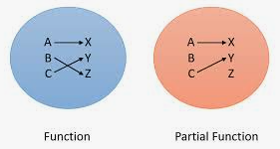
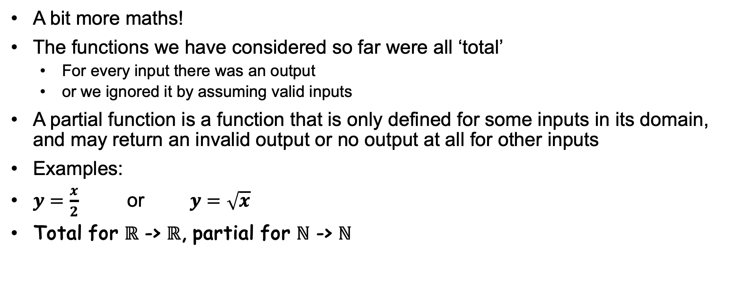
Partial and total functions
A bit more maths!
The functions we have considered so far were all ‘total’
For every input there was an output
or we ignored it by assuming valid inputs
A partial function is a function that is only defined for some inputs in its domain, and may return an invalid output or no output at all for other inputs
Examples:
$y=\frac{x}{2}$ or $y=\sqrt{x}$
Total for $ℝ$ -> $ℝ$, partial for $ℕ$ -> $ℕ$

Slide 19
Why should we care (unless we want to do maths?)
Partial functions are only defined for some inputs
So they are ’magically’ capturing scenarios with invalid inputs!
Consider a function that needs a credit card number or a phone number as input; if the input is something else it should return an error
Or a function that converts a Char to an Int (not to the ASCII/ Unicode value, but the character ‘1’ to 1.) If you try to convert ‘a’ it should give an error
In some programming languages you might use a NULL pointer for this
e.g. Java would return a NULL pointer when it can’t find an object you refer to

Slide 20
The return of the Higher-order function!
Recall:
Definition: A higher-order function is a function that takes a function as input and/or returns a function as output
So, we need to parametrize the order function in our sort algorithms
Let’s fix the type signatures
quicksort :: Ord a => (a -> a -> Bool) -> [a] –> [a]
insertsort :: Ord a => (a -> a -> Bool) -> [a] –> [a]
Notes:
Look back at where the <, > etc was used …

Slide 21
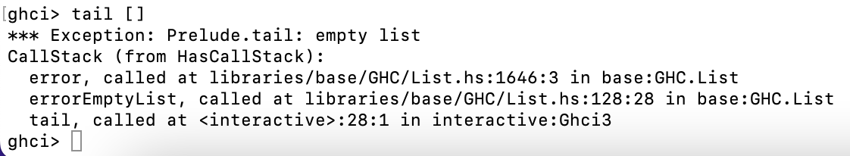
Tail and head from prelude
Try calling head or tail on an empty list …
… and it fails with an error as it is not defined
head :: [a] -> a
tail :: [a] -> [a]
Notes:
Look back at where the <, > etc was used …

Slide 22
Say hello to Maybe
Haskell can define partial functions
This is done with a data type called Maybe
data Maybe a = Just a | Nothing
We can now write a safe ‘head’ function
safeHead :: [a] -> Maybe a
safeHead [] = Nothing
safeHead (x:xs) = Just x
Notes:
Look back at where the <, > etc was used …

Slide 23

This Photo by Unknown Author is licensed under CC BY-SA-NC

Slide 24
Grammar for (simple) Math Expressions
To help you with Coursework Part 1
A grammar captures the structure of ‘languages’; it gives you a structure for writing functions to work (in this case) with algebraic expressions with integers; think of them as ‘rewrite rules’
Grammars are not specific to functional programming
<expression> ::= <term>
<expression> ::= <expression + <term>
<expression> ::= <expression - <term>
<term> ::= <factor>
<term> ::= <term> * <factor>
<term> ::= <term> / <factor>
<factor> ::= <non-negative integer>
2 + 3 * 4
expression
expression
+
term
term
term
*
factor
factor
factor
4
2
4

Slide 25
This week we looked at AVL trees following your lab task; we also considered the Maybe datatype as a way of handling errors. Finally, we also had a quick look at Maths expression grammars.

